Slide 1
Welcome to Our Presentation
ABC’s of Investing
Notes:
Welcome the group to this ABC’s of Investing overview and tell them you’ll only need 21 minutes of their time.

Slide 2
ABC’s of Investing
This discussion is offered free of charge. It is designed to be educational in nature and is not intended to provide tax or legal advice. Consult with your tax advisor and/or legal counsel for suitability for your specific situation.
Hypothetical and/or actual historical returns contained in this presentation are for informational purposes only and are not intended to be an offer, solicitation, or recommendation. Rates of return are not guaranteed and are for illustrative purposes only. Past performance is no indication of future returns.
Projected rates do not reflect the actual or expected performance within any example or financial product.
Disclosure
Insurance products are sold through
(Your Company Name Here)
Notes:
Point the prospects to the disclosure page and tell them they can read it at their leisure.

Slide 3
A Few Questions
Do you know how all of your assets (stocks, bonds, mutual funds, annuities, Life Insurance, etc.) work together to achieve the amount of risk you want in your total portfolio?
How does your current portfolio protect you in case of a bear market?
How does the average person determine which assets to use in a conservative portfolio?
What is your plan to manage risk?
Do you need a degree in finance to know how to manage risk?
Notes:
Read the questions. Tell them that if they are like most people they don’t know the answers to the first four questions and that would make them normal. Tell them they probably assume the answer to the last question is yes or at least it feels that way.
Let’s take a quick look at a planning model that may very well be an answer to those difficult questions in investing. It’s called the ABC Planning Process.

Slide 4

Maybe it’s time for a PhD in the ABC’s!
Notes:
Let’s take a quick look at a planning model that may very well be an answer to those difficult questions in investing. It’s called the ABC Planning Process.

Slide 5



Three Green Money Rules:
Rule #1: Protect Your Principal
Rule #2: Retain Your Gains
Rule #3: Guarantee Your
Income
.5% - 1.5%
3% – 7%
+30% – -30%
Three RED Money Rules:
Rule #1: Must be tactical
Rule #2: Must be liquid
Rule #3: Must be long term
Taxable
Liquid
Bank
CDs
Savings
Checking
Tax-Deferred
Moderately Liquid
Taxable
Liquid
401k
IRA’s
Stock/Bond
10%
60%
30%
Notes:
Let’s divide assets into categories, A, B, and C, which represent three types of assets. Category A is your cash reserves. Cash assets potentially carry low returns, but the principal is guaranteed, and interest is compounded. According to the Federal Reserve the average six month CD rate from 1990-2009 was 4.37% (20 years); 2000-2009 was 3.32% (10 years); from 2005-2009 was 3.99% (5 years).(1) It is interesting to note the average inflation rate from 2000-2009 was 2.57%, which leaves the five year return averaging less than 1.5% before taxes. (2)
These accounts are typically taxable and have optimum liquidity. However, they can also be set up in various tax-advantaged strategies such as traditional IRA’s, Roth IRA’s, etc. Most often these are bank held assets like CDs, savings accounts, and money markets.
Financial advisors will often refer to this as short term money, or emergency funds. If your furnace breaks down, your roof leaks, or you have a medical emergency, category A is where you save for such an occurrence. If you are saving for an exciting vacation or a new car, this is where the money goes. It is also where you might want to keep a savings account to replace any income lost due to a prolonged illness, injury, or job loss. Commonly, financial advisors will tell you to have six months to a year of income put away for these instances. The illustration below shows Column A assets. Imagine them as “Yellow Money” accounts.
The second category is Column B, the Green Money Column, and holds Protected Growth assets. They offer potentially moderate returns, are tax-deferred and offer partial withdrawals. The principal is protected, and previous years gains are retained as interest. The annual returns on these assets vary greatly. In my own practice I have seen them yield from 0% to as high as 16%. Some include bonuses from 3% to 7%. These assets are designed to be the middle ground between CDs and the market.
I prefer using fixed indexed annuities in column B which link the interest credits to the performance of a market index, such as the S&P 500, S&P Midcap 400, DOW, Russell 2000, Euro Dow, etc. Column B money is set aside for a longer period, often 5-10 years. Annuities have strings attached for withdrawals, but can be an excellent source of income over a lifetime. In other words, don’t allocate money to the B column
Generally assets in this column offer only partial withdrawals without a penalty, yet many include riders that waive surrender fees in the event of a nursing home stay or terminal illness. Indexed annuities are designed to function as the middle ground between lower interest rates of bank CDs and savings accounts, and the potential higher returns of risk oriented market money.
This is the Fixed Principal Asset column, where the principal is protected. The ABC Model looks at Fixed Income Assets different than Wall Street does. Over the years, Wall Street has used a laddered portfolio of bonds to accomplish the goals of column B, yet a bond can lose value. From 1999 to 2009, if you were holding Lehman Brothers, Bear Stearns, ENRON, or World Com bonds, you might have thought you were safe, but found out just how much you could lose in a bond. If you are holding a California bond right now you might be a little insecure. That is why we use Fixed Principal Assets in column B rather than Fixed Income Assets.
Column C represents our Red Risk Growth assets which move up or down with the market. Investors usually chase higher returns over time, though these assets can gain or lose 30% in a year or even more. The S&P 500 lost 38% in 2008, but the average annual return from 1995-1999 was over 25%. (4) The market “giveth” and the market “taketh” away, there are no protections or limits. This money is invested in securities like stocks, bonds, mutual funds, variable annuities, options, REITs, and the like. The principal isn’t protected and last year’s gain may be lost in a downturn of the market. While these accounts are associated with a longer time horizon they are usually more liquid due to the “sellable” nature of securities, unless they are in a variable annuity which offers partial withdrawals.
The majority of the assets found in column C are in retirement accounts such as 401(k)’s, 403(b)’s, IRA’s and variable annuities. Column C monies can also be found in the form of non-qualified (after-tax) brokerage accounts, mutual funds, stocks, or bonds, held by an individual, jointly, or even in trust. You can be your own manager or hire a professional investment adviser to manage this part for you. Let’s paint these investments Red for Risk.
Sometimes it’s confusing as to which assets belong in which column. Column B has Three Green Money Rules which are: Protect your principal, retain your gains, and guarantee your income. If an asset can’t do those three things it doesn’t belong in the ABC Model’s Column B. Bonds don’t follow those rules so they must go in the next Column C. Therefore, a Fixed Indexed Annuity is probably an ideal asset for column B.

Slide 6
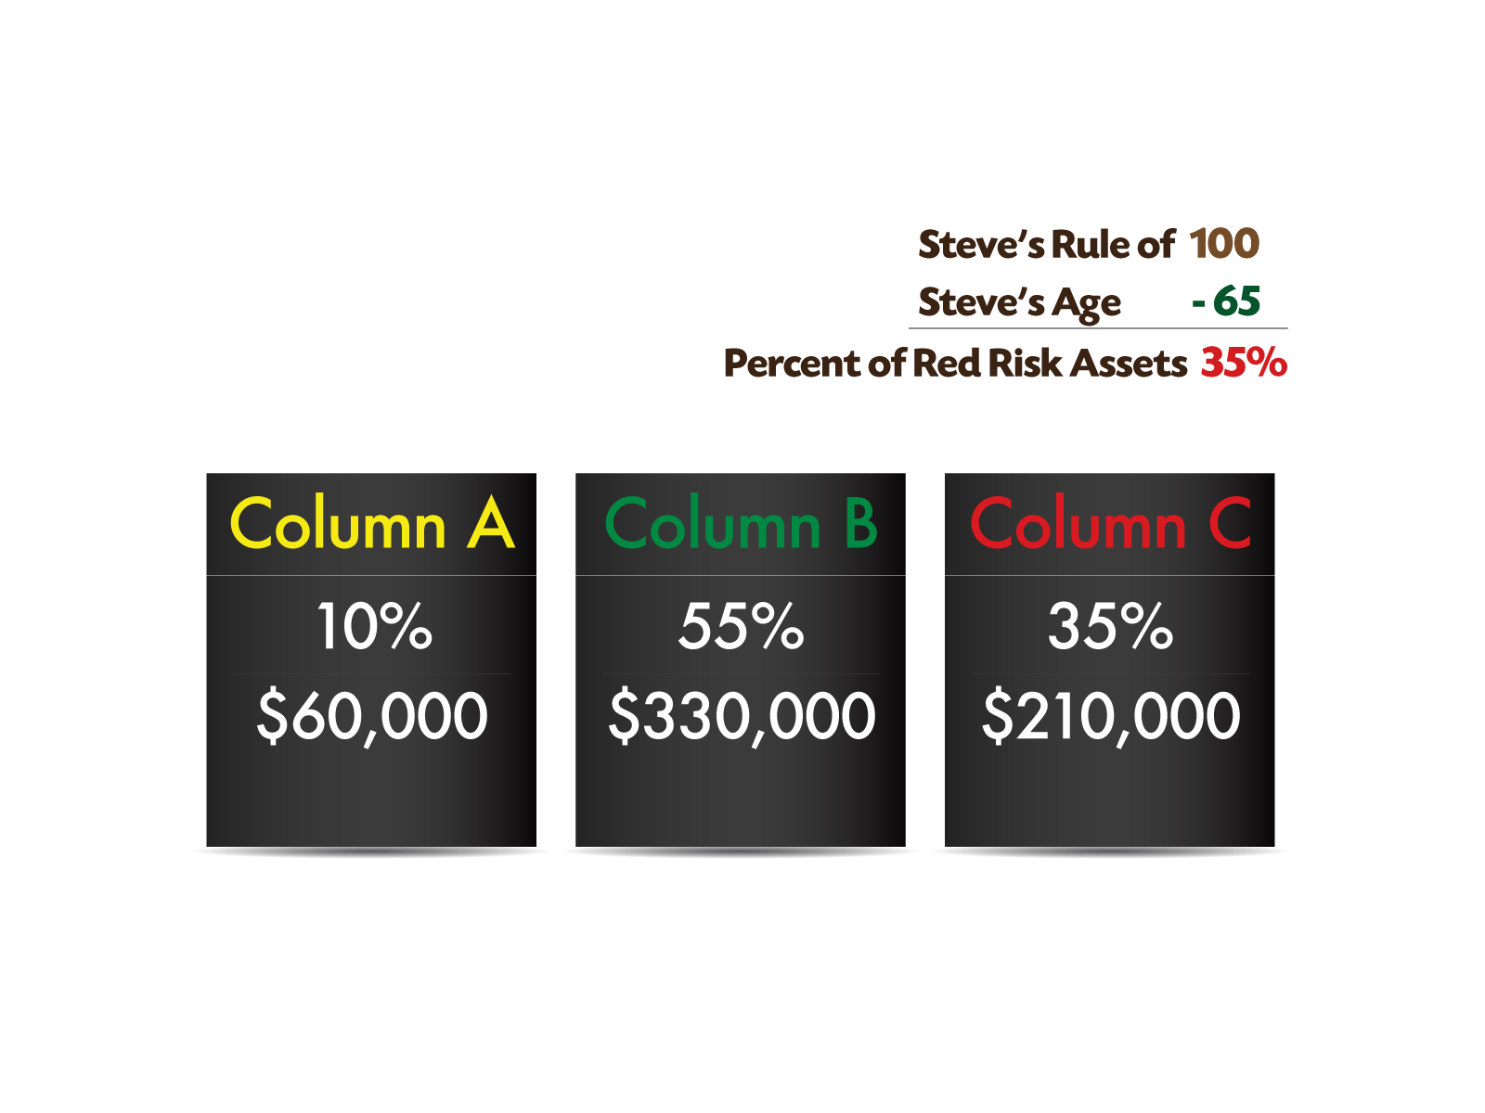
Anxious Steve’s Allocation of $600,000
Notes:
Finally, you might not have a clue how much money you want in each column and need a little guidance. It might be helpful to picture money as being either GREEN or RED; GREEN for Safe and RED for Risk. GREEN Safe money is money not exposed to risk in the market. RED Risk money is just that, money in the market.
It might also help to picture my friend Steve the Anxious Investor. He’s a 65 year old retired salesman with $600,000 of investible assets. Steve’s advisor suggests an often used formula called the Rule of 100 to help him determine how much he wants in Columns A, B, and C.
Very simply he used the formula of 100 minus his age, to determine how much money he wants in Green protected accounts and Red risk accounts.
Steve decides to put 65% in the first two columns. Steve first determines he wants 10 % or $60,000 in Column A for an emergency fund, plus he’s planning a vacation in the Bahamas. Next, he puts the balance of the green money portion from the Rule of 100 which is 55% or $330,000 in a laddered portfolio of indexed annuities in Column B. Steve has 35% or $210,000 left to be placed in Column C’s Red Risk assets. He chooses a professional money manager who manages a conservative portfolio of funds.
Steve is finally able to find peace with his assets and isn’t anxious anymore because he knows what percentage of his retirement assets are “safe” and what percentage of his retirement assets are at risk.

Slide 7
What is your greatest priority?
What are you willing to give up?
Gains? Liquidity? Protection?
Cash
Protective Growth
Risk Growth
Potentially lower returns
Taxable or tax-deferred
Liquid
Potentially moderate returns
Tax-deferred
Offer partial withdrawals
Potentially higher returns
Taxable or tax-deferred
Offer partial withdrawals or liquid
Liquidity
Protection
Gains
Gains
Liquidity
Protection
Notes:
Now let’s take a glance at what you gain and lose in each column. There is a “Risk-Reward” for each column, which means, you stand to gain or lose something by placing assets in each scenario.
If your main goal in placing money in column A is good liquidity, you will probably have to put up with low interest rates. So, you would be capturing liquidity and losing some potential gains. If what you want by placing money in Column C is higher potential gains, you will have to give up protection of those assets. If you want the protection of Column B, then you will have to consider a longer-term mindset, putting up with 10% liquidity each year.
Said differently, in Column A you give up GAINS to get more LIQUIDITY. In column B you give up some LIQUIDITY to acquire PROTECTION from risk, and in Column C you give up POTECTION for higher potential GAINS, as illustrated.

Slide 8
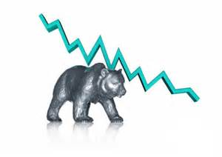
We Live in Perilous Times!
On Average
Every 3 years you have a bear market.
Every 8 years you have a significant bear market.
If you hold your money for 17 years you won’t have a problem.
This bear started in 2000.
“The Anatomy of a Bear” Napier 2005
Notes:
Russell Napier in his book “The Anatomy of a Bear” points out these facts (read them). If they are true then we live in perilous times. How should you plan in a time like this? The “old models” of investing and asset allocation don’t really work anymore. The markets move at the “speed of information”. These dramatic swings in the stock market (up 150 points one day and down 200 hundred the next) is a relatively new phenomena. We’ve only seen this type of market activity develop over the past 10-12 years. Prior to that up or down 35 points was a big move for the market. A different world has resulted in a new and different market, which calls for a new investment model.

Slide 9

A Plan to Keep Your Retirement Assets from Being Subject to a Repeat of Negative History.
Notes:
The ABC Model of Investing is a powerful tool to manage risk so you won’t repeat negative history. Let’s see how it works by looking at different decades of the 21st Century.

Slide 10
What if a Bear Market Happened Again?

Slide 11
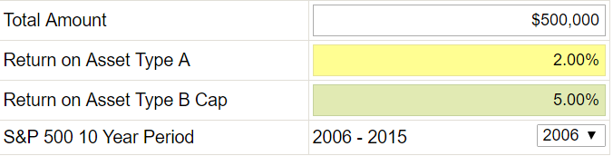
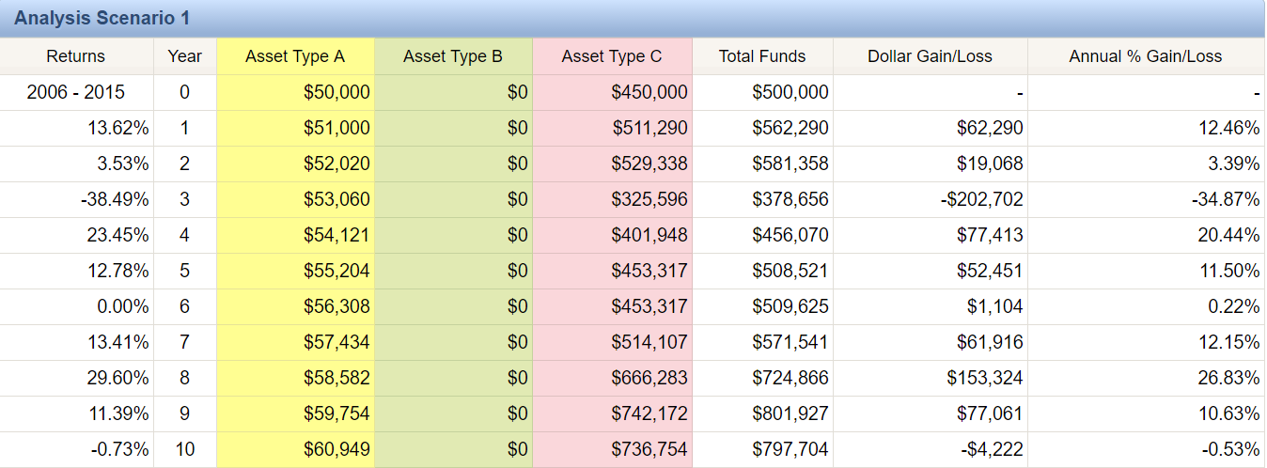
2006 through 2015
Hypothetical and/or actual historical returns contained in this presentation are for informational purposes only and are not intended to be an offer, solicitation, or recommendation. Rates of return are not guaranteed and are for illustrative purposes only. Past performance is no indication of future results. The S&P 500 is not available for direct investment.
Chart: Retirement Analyzer Software 2016™
Notes:
The hypothetical illustration above shows the S&P 500 returns for the years 2006 through 2015 on the left. The investible assets are $500,000. This hypothetical example shows a typical investor who has about 10% in cash earning an average of 2% and 90% allocated to the market (through 401(k), 403(b), IRA’s etc.) represented by the S&P 500. We use the broad market index to approximate what investing in the market in general was like over that period of time. Certainly an investor could have been in more or less risk than illustrated here. Yet, the hypothetical illustration shows in general terms how the market performed from 2006-2015 Notice, there are no monies allocated to Column B, which are Index Annuities.
The hypothetical chart shows at the end of the ten year period this investor would have grown their portfolio to over $797,700. So it looks like a very good decade in the market, except for that one glitch in 2008, a 38.5% loss.
Hypothetical and/or actual historical returns contained in this presentation are for informational purposes only and are not intended to be an offer, solicitation, or recommendation. Rates of return are not guaranteed and are for illustrative purposes only.
Next slide

Slide 12
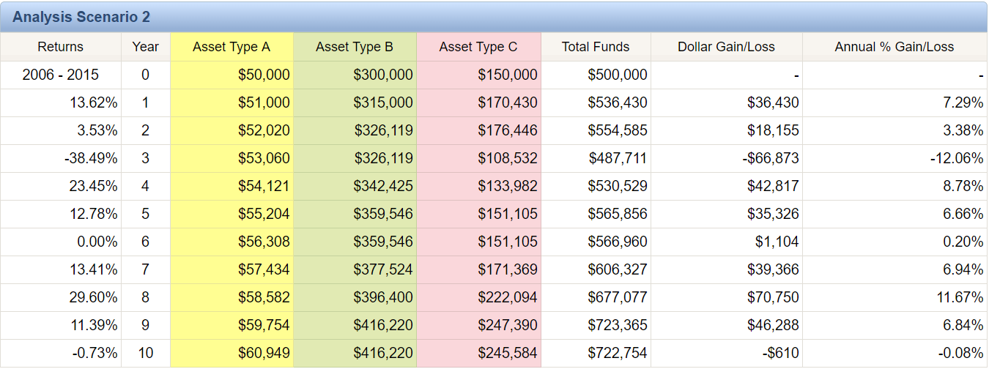
2006 through 2015
$-74,949
Hypothetical and/or actual historical returns contained in this presentation are for informational purposes only and are not intended to be an offer, solicitation, or recommendation. Rates of return are not guaranteed and are for illustrative purposes only. Past performance is no indication of future results. The S&P 500 is not available for direct investment.
Chart: Retirement Analyzer Software 2016™
Notes:
Using the same $500,000 over the identical ten year scenario, let’s allocate 60% to laddered maturities* in indexed annuities. Using the same caps and interest rate in the previous illustration, the ABCs with 60% allocation to Green Money didn’t perform as well. This hypothetical portfolio grew to $722,754 during that same period of time. That’s about a 9% difference in the overall performance; approximately .9% per year, about $7,500 less per year. Why?
Bull Market – this 10 year period of time is considered to be one of the most historic bull runs we’ve ever experienced
Green Money is NEVER designed to outperform Red Money. It is the middle ground between bank assets and the market. Look at what happened to the Red Money in 2008. Then look at what happened to the Green Money in 2008. You didn’t lose a dime! The purpose of Green Money is preservation of principal with the potential for modest growth. So, a conservative investor is willing to give up some of the gains in exchange for PROTECTION of their assets in the event a market takes a downturn like it did in 2008, and the early part of 2016.
This is just one 10-year period of time that likely will never be repeated exactly this way again
Let’s take a look at a couple of Bear market decades, remembering that you need to plan for 30 years in retirement. Let’s see if the ABC Allocation makes any difference.
(*Maturity = Out of Surrender Penalty Period)
Next slide

Slide 13
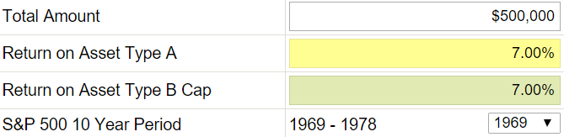
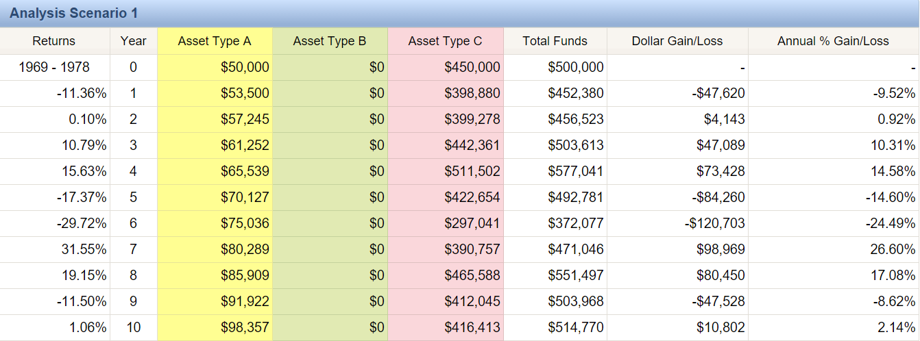
1969 through 1978
$-74,949
Hypothetical and/or actual historical returns contained in this presentation are for informational purposes only and are not intended to be an offer, solicitation, or recommendation. Rates of return are not guaranteed and are for illustrative purposes only. Past performance is no indication of future results. The S&P 500 is not available for direct investment.
Chart: Retirement Analyzer Software 2016™
Notes:
The illustration above shows the S&P 500 returns for the years 1969 through 1978 on the left. How many of you remember that decade?! The investible assets are $500,000. This example uses the same criteria for caps in the index annuities, but uses the 7% average bank rate for the decade. Wouldn’t you love that again! We use the broad market index to approximate what investing in the market in general was like over that period of time..
The chart shows at the end of the ten year period this investor would have gained a little over $14,770. Look at all the negative years in that decade! 4 out of 10 years were negative, and 2 years that had almost no growth!
You were letting out a big exhale because you just made it through a very rough 10 year period of time and you could breathe again!
So, let’s take a look at how an ABC allocation during this same time period of time might have performed…

Slide 14
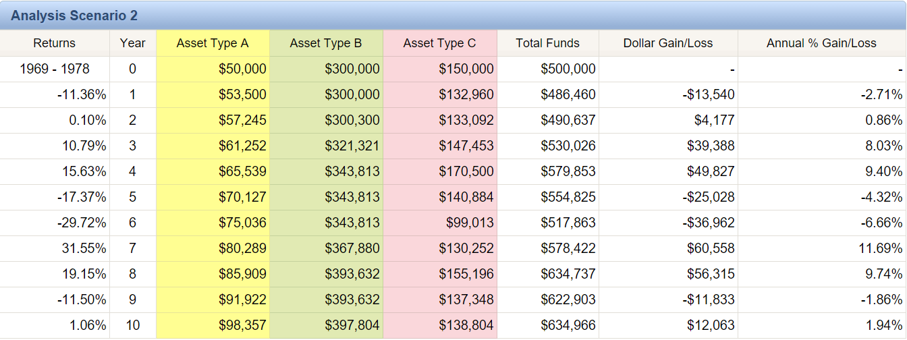
1969 through 1978
$-74,949
$120,195
Hypothetical and/or actual historical returns contained in this presentation are for informational purposes only and are not intended to be an offer, solicitation, or recommendation. Rates of return are not guaranteed and are for illustrative purposes only. Past performance is no indication of future results. The S&P 500 is not available for direct investment.
Chart: Retirement Analyzer Software 2016™
Notes:
The ABC allotment of 10/60/30 grows by more than $134,900, which is a $120,195 difference! That’s with 4 out 10 years negative, and 2 years with almost no growth! Very positive toward the ABC bear market strategy for retirement.
Now let’s take a look at a really nasty decade. One we’re all familiar with.
Next slide.

Slide 15
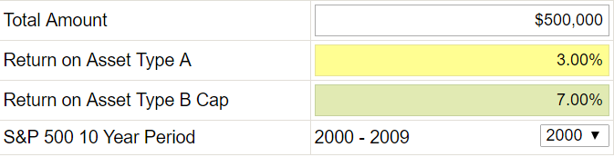
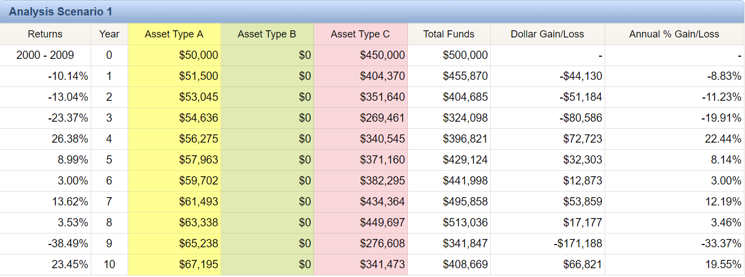
2000 through 2009
$-74,949
Hypothetical and/or actual historical returns contained in this presentation are for informational purposes only and are not intended to be an offer, solicitation, or recommendation. Rates of return are not guaranteed and are for illustrative purposes only. Past performance is no indication of future results. The S&P 500 is not available for direct investment.
Chart: Retirement Analyzer Software 2016™
Notes:
The hypothetical illustration shows the S&P 500 returns for the years 2000 through 2009 on the left. The investible assets are $500,000. This example shows a typical investor who has about 10% in cash earning an average of 3% and 90% allocated to the market represented by the S&P 500. We use the broad market index to approximate what investing in the market in general was like over that period of time. Certainly an investor could have been in more or less risk than illustrated here. Yet, the illustration shows in general terms how the market performed from 2000-2009. Notice, there are no monies allocated to Column B, which are Index Annuities.
The hypothetical chart shows at the end of the ten year period this investor would have lost $91,330 ($500,000 - $408,669). I don’t know about you, but an 18% loss in my portfolio is devastating when it comes to retirement! Imagine if you were 55 years old in 2000 and planning to retire when most people do, at age 65. Would you do what many have had to do, which is work another 3-5 years (or more) in hopes of recovering those assets needed to retire? Isn’t that what many people did after 2008-09? They saw major losses in their portfolio and realized they had to work “a few more years” in order to get back what they had lost.
And what if it happens again? When I show this graph to students they tell me, “Yep, that’s about what happened to us.” Yet, the same students will surprisingly stay in this broken down Wall Street model attempting to recover with a hope and a prayer.
What if the next ten years aren’t any better than this decade? Can you afford to lose another 10%, 15% or possibly more? Can you continue to push off your retirement indefinitely? Let’s do some math: If you lose 25% of your total account value in one year, what percentage do you have to make the next year just to get back even? $100,000 – 25% = $75,000 x 33% = $100,000. These types of losses can have a devastating impact on a retiree’s lifestyle. What if the first 10 years of your retirement looked like this?
There has to be a better way, and I believe there is.
Next slide.

Slide 16
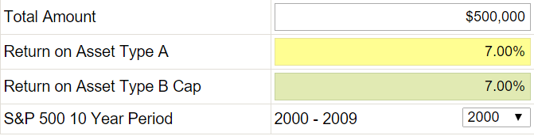

2000 through 2009
  What if the next ten years saw a 10%, 20% or 30% loss in the market? How would it affect your retirement?
$191,684
Hypothetical and/or actual historical returns contained in this presentation are for informational purposes only and are not intended to be an offer, solicitation, or recommendation. Rates of return are not guaranteed and are for illustrative purposes only. Past performance is no indication of future results. The S&P 500 is not available for direct investment.
Chart: Retirement Analyzer Software 2016™
Notes:
Using the 10/60/30 ABC split, this person gains $100,354 instead of losing over $91,000! A difference of $191,684.00. Now that’s a strategy that works for retirement years. It does so because it obeys Warren Buffet’s first rule of investing, “Never lose any money.” BTW, that happens to be rules number 2 and 3 also. And it has to be true, especially for retirees or those heading into retirement.
Simply putting some of your money in the green money column protects you from those down years and now with the tremendous guaranteed income payouts the green money column is even more “a must” for retirees. We don’t want you to get totally out of the red, or growth money assets, but it’s obvious that the green money column is perfect for conservative clients looking for alternatives to Wall Street’s roller coaster rides.
Hypothetical and/or actual historical returns contained in this presentation are for informational purposes only and are not intended to be an offer, solicitation, or recommendation. Rates of return are not guaranteed and are for illustrative purposes only.

Slide 17

So, What Now?
None of this made sense to you or you’re just not interested.
You are intrigued by the ABC’s and would like a complimentary ABC profile.
You are curious and would like to receive information on our next event.
Notes:
In the end, here’s what I are looking for; a few high-trust, long-term relationships with client-partners. Here’s what I mean my client-partner.
First, I want to say that as a planner, I hate asking for referrals. It is uncomfortable for me and for my clients. I think its imposing on them. Advisors have used the same tired old tactics to ask for referrals forever. It is distasteful. I just do not believe in it.
Something I do believe in is a partnership between the client and advisor. The advisors role is to create, implement, and adjust the financial plan tailored to the needs of the client. The advisor is partnering with the client to see them succeed in their retirement. Partnership is a two way street by definition. The role of this client partnership is very important.
The role of the Client-Partner is to talk with others about the experience of working with the advisor and invite them to meet the advisor at a client event, workshop, or at an individual conference. As you are out in the community with your friends, family, and acquaintances the subject of finances comes up. All you need to do is say, “you might want to speak with Tom.” If they say they already have an advisor, drop the subject. Yet, if they ask you who your advisor is, tell them about this “experience” with the ABC’s of Conservative Investing. Then simply invite them to meet with you and me for lunch (I will pay), or invite them to the next client event or workshop. This will enable your friend to meet me in a casual setting to see if this proven method is interesting, and if I’m the “kind of person” they might want to work with.
You can always call me after speaking with your friend and get permission to have them call or come to an event. The advisor can take it from there.
The relationship of an advisor and client-partner can be a long and prosperous one for both parties. Bringing your friends who have expressed a financial need to meet your advisor is a major compliment. Finding an advisor you trust, like, and is competent makes it all the more enjoyable.
Read slide as you hand out the response form. Thank them for their time and tell them they are free to go. Follow up with those who asked to learn more or to meet with you.

